Slide 1
Shared Health Priorities: Measuring Access to Mental Health and Substance Use Services and to Home and Community Care
Overview and Update
Canadian Institute for Health Information
November 2023
sharedhealthpriorities@cihi.ca

Slide 2
Achieving FPT consensus around comparable data and public transparency
Shared federal, provincial and territorial (FPT) priorities:
The growing demand for access to health services at home or in the community to help Canadians manage their health conditions and live safely at home
The need for Canadians of all ages to have timely access to mental health and substance use services
2017: FPT governments* endorsed A Common Statement of Principles on Shared Health Priorities (SHP) along with an $11 billion federal investment in home and community care and mental health and substance use services.
CIHI received funding to lead a process working with stakeholders to select and develop a common set of pan-Canadian indicators, which are now being publicly reported.
Note * The federal government agreed to an asymmetrical arrangement with Quebec, distinct from the Common Statement of Principles.

Slide 3
Phase 1: Indicator selection
Within 6 months, CIHI led a selection process to reach FPT consensus on 12 new indicators
Engaged FPT reps (nominated by deputy ministers of health), pan-Canadian health organizations (PCHOs), clinicians, researchers, system managers and the public
Helped to reach agreement on the most important aspects of access, and the evaluation criteria needed for selection
Created and reviewed a list of 100+ possible measures in each sector, through environmental scans and a modified Delphi exercise
Worked with provinces and territories to reach consensus
Indicator list endorsed by Conference of Deputy Ministers of Health, followed by health ministers in June 2018

Slide 4
Phase 2: Indicator development and reporting
CIHI led collaboration among FPT governments, Statistics Canada, PCHOs (Mental Health Commission of Canada, Canadian Centre on Substance Use and Addiction, and Canadian Home Care Association), measurement and sector experts, and people with lived experience to deliver on performance measurement commitments.
3 key elements
Advance data collection
Conduct targeted activities to prioritize and fill data gaps and look beyond traditional data sources
Measure and report on indicators
Develop and enhance standard definitions for comparable measurement
Report on what is available and expand over time
Accelerate uptake and use
Conduct targeted activities to increase stakeholder awareness and understanding
The value of this work and actionability builds over time

Slide 5
Key accomplishments
Advance data collection
Brand-new data collection
Wait time data for mental health counselling
Wait time data for home care services
Survey data on home care effectiveness (Statistics Canada)
Self-reported mental health and substance use information on
Ability to navigate services
Early intervention among children and youth
Data with expanded geographic coverage
Long-term care data
Home care data
Higher-quality, more detailed data
Emergency department data on mental health and substance use
Improved specificity of substance use in hospital data

Slide 6
Key accomplishments (continued)
Measure and report on indicators
Accelerate uptake and use
Confirmed measurement approach for 12 indicators, with refinements and expanded data over time
Published results for all 12 indicators plus 4 companion reports
Published locally relevant results through region-level reporting (where data supports)
Included equity/demographic stratifiers
Used plain language communication for reporting
System impacts include regulatory changes, investment decisions and information campaigns
Healthcare Excellence Canada’s Priority Health Innovation Challenge targeted program and service improvements in SHP measurement areas
Top tier media coverage, conference and stakeholder presentations, and journal articles have raised awareness

Slide 7
Indicator reporting
Year | Indicators
2019 (Year 1) | Hospital Stays for Harm Caused by Substance Use* | Frequent Emergency Room Visits for Help With Mental Health and Substance Use* | Hospital Stay Extended Until Home Care Services or Supports Ready†
2020 (Year 2) | Self-Harm, Including Suicide* | Caregiver Distress† | New Long-Term Care Residents Who Potentially Could Have Been Cared for at Home†
2021 (Year 3) | Wait Times for Community Mental Health Counselling* | Wait Times for Home Care Services† | Home Care Services Helped the Recipient Stay at Home^{†i}
2022 (Year 4) | Navigation of Mental Health and Substance Use Services* | Early Intervention for Mental Health and Substance Use Among Children and Youth* | Death at Home or in Community†
* Mental health and substance use
† Home and community care
Note
i. Indicator development for Home Care Services Helped the Recipient Stay at Home led by Statistics Canada.

Slide 8
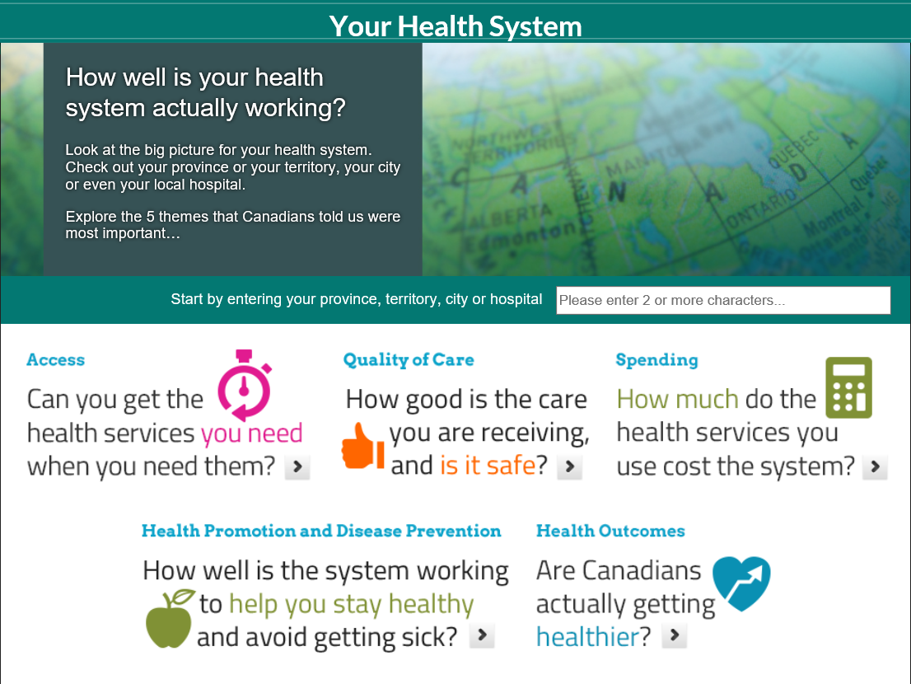
Public reporting approach
Indicators
Released in Your Health System (YHS): In Brief (web tool for the general public)
Reporting at the provincial/territorial level and region level (where data supports)
Metadata included in CIHI’s Indicator library
Additional information via the Shared Health Priorities web page
Companion report
A series of reports that focused on new indicators
Provided additional contextual information, interpretative notes and data breakdowns

Slide 9
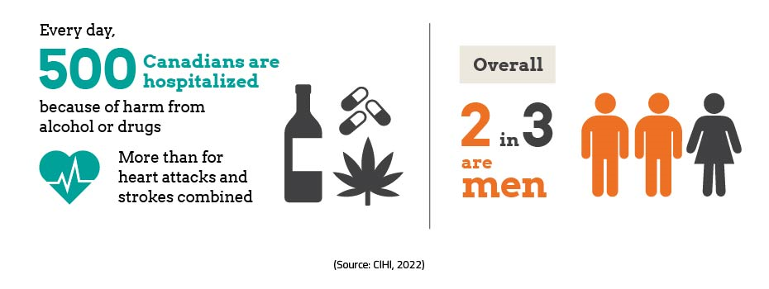
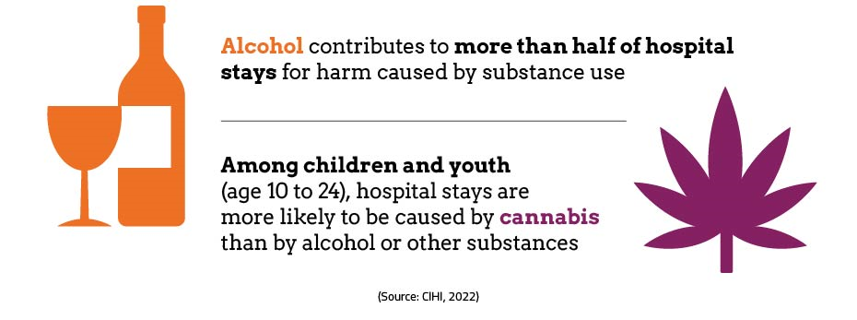
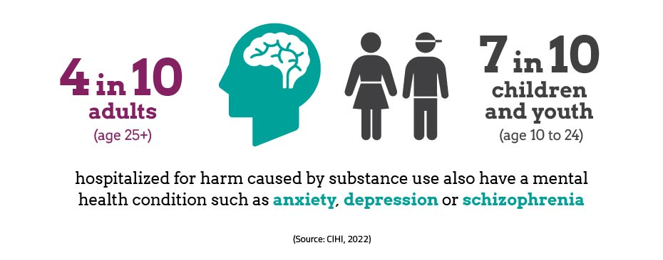
Indicator reporting example Hospital Stays for Harm Caused by Substance Use, 2022–2023 (per 100,000) — Indicator results
Definition: The rate of hospital stays as a direct result of using alcohol, cannabis and other substances.

Slide 10
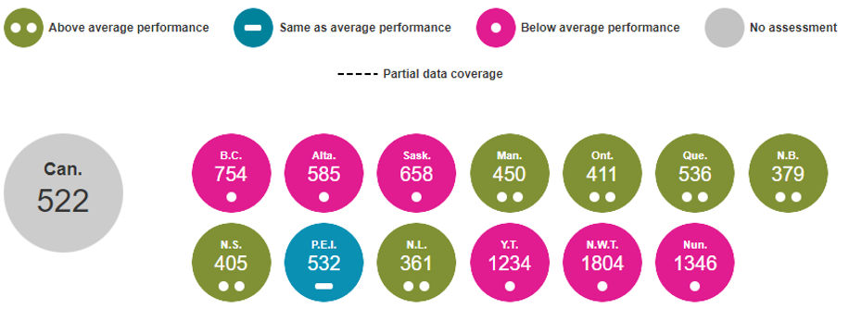
Indicator reporting example (continued) Hospital Stays for Harm Caused by Substance Use, 2022–2023 (per 100,000) — Indicator results
Notes
Canada rate is based on all data submitted to CIHI.
Sex-, age- and substance-specific results are also available for this indicator.
Key links
Indicator results with additional breakdowns are available in YHS: In Brief.
More information on the indicator, as well as contextual information, is available in the 2019 companion report.

Slide 11
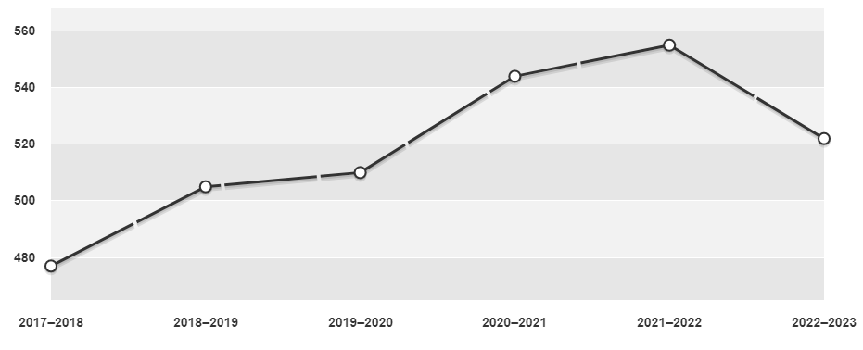
Indicator reporting example (continued) Hospital Stays for Harm Caused by Substance Use, per 100,000 (2017–2018 to 2022–2023) — Trend results
Note
Customizable graphs and interactive maps also available.
Key link
YHS: In Brief.

Slide 12
SHP indicators with region-level results in YHS
Hospital Stays for Harm Caused by Substance Use
Frequent Emergency Room Visits for Help With Mental Health and Substance Use
Hospital Stay Extended Until Home Care Services or Supports Ready
Caregiver Distress
New Long-Term Care Residents Who Potentially Could Have Been Cared for at Home
For Self-Harm, Including Suicide, region-level results for Self-Harm Hospitalizations are available in Your Health System: In Depth

Slide 13
Overall key messages
Over time, the SHP indicators will tell a clearer story about access to care across the country and will help identify where there are gaps in services.
Understanding where gaps exist will help improve care at the front lines and better meet the needs of Canadian patients and their families.
Reporting on each of the indicators will not lead to immediate change. The COVID-19 pandemic has also impacted these sectors in many ways. Results from the pandemic period, and trends over time, should be interpreted with caution.
Considerable efforts are being made by the provinces and territories to expand coverage in existing data holdings, to improve data quality, to develop common information standards and to explore new data sources for public reporting. Indicator results will be updated and refined as more and better data becomes available.
In early 2023, additional SHP areas were identified by federal, provincial and territorial governments for measurement and reporting. CIHI is working with stakeholders to advance this work.

Slide 14
Appendix A
Indicators of access to mental health and substance use services

Slide 15
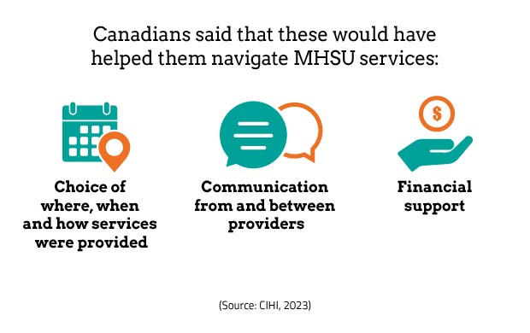
Navigation of Mental Health and Substance Use Services Key findings, 2023
Definition: Proportion of individuals age 15 and older who said that they always or usually had the support necessary to navigate mental health and substance use (MHSU) services in the past year once they accessed services.

Slide 16
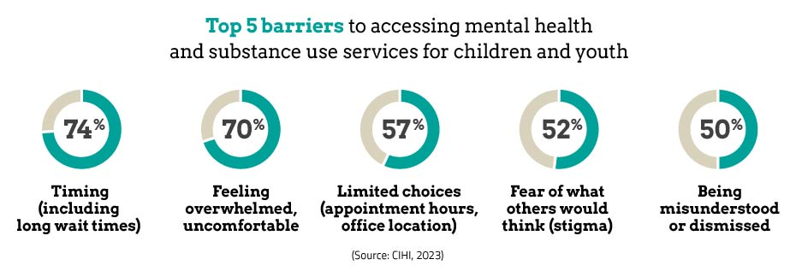
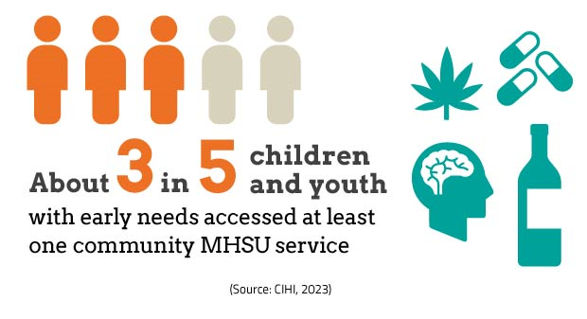
Early Intervention for Mental Health and Substance Use Among Children and Youth Key findings, 2023
Definition: Proportion of individuals age 13 to 24 with early mental health and substance use (MHSU) needs who accessed at least one community-based MHSU service in the last 6 months​.

Slide 17
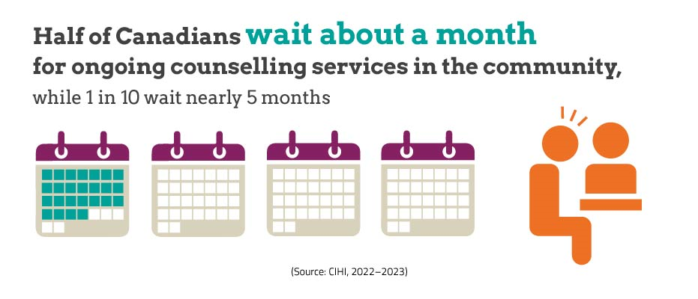
Wait Times for Community Mental Health Counselling Key findings, 2022–2023
Caution should be used when interpreting this data. The data comes from independent provincial and territorial systems, which have known variations in definitions. There is a commitment among jurisdictions to work toward harmonizing definitions and improving comparability of results.
Definition: The median number of calendar days a client waited for ongoing counselling services from the date the initial referral was received to the date of the first scheduled/booked counselling session.

Slide 18
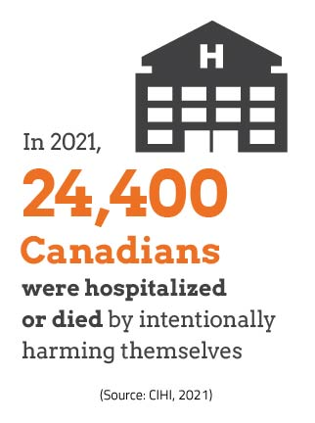
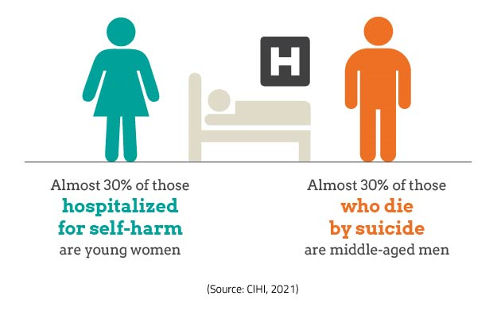
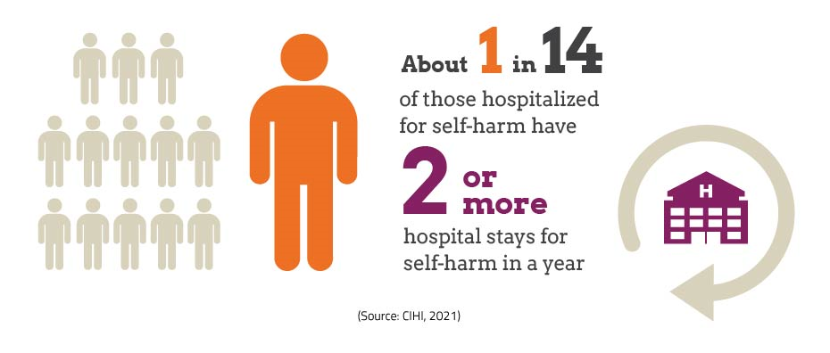
Self-Harm, Including Suicide Key findings, 2021–2022
Definition: The rate of self-harm hospitalizations and self-harm deaths (suicides) per 100,000 population age 10 and older.

Slide 19
Hospital Stays for Harm Caused by Substance Use Key findings, 2022–2023
Definition: The rate of hospital stays as a direct result of using alcohol, cannabis and other substances.

Slide 20
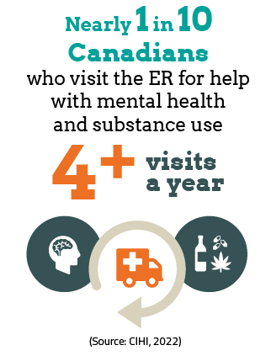
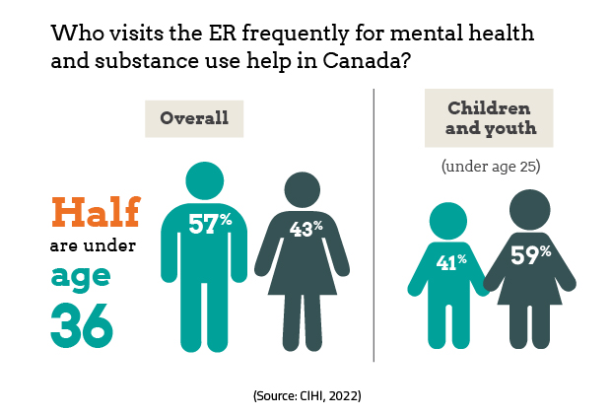
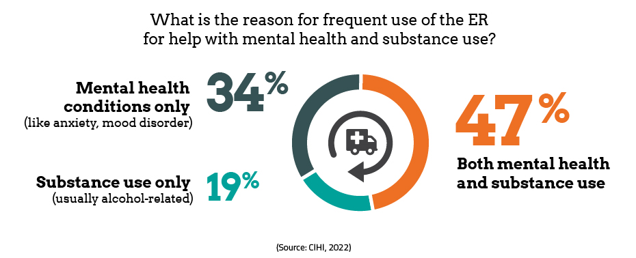
Frequent Emergency Room Visits for Help With Mental Health and Substance Use Key findings, 2022–2023
Definition: The proportion of frequent visitors (with at least 4 visits a year) among those who visit an emergency room for help with mental health and substance use.

Slide 21
​Appendix B
Indicators of access to home and community care

Slide 22
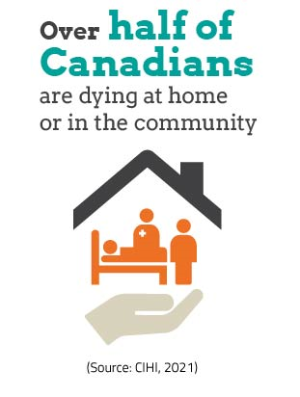
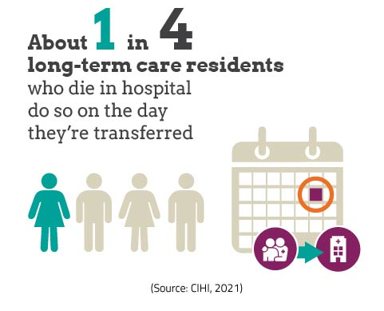
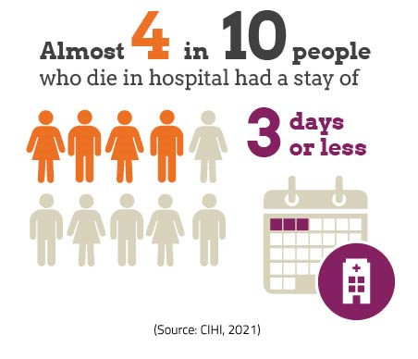
Death at Home or in Community Key findings, 2021 (calendar year)
Definition: The percentage of people who die at home or in the community each year.

Slide 23
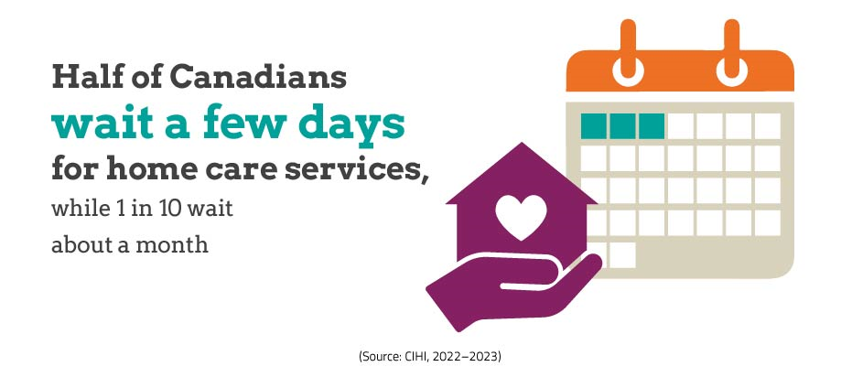
Wait Times for Home Care Services Key findings, 2022–2023
Caution should be used when interpreting this data. The data comes from independent provincial and territorial systems, which have known variations in definitions. There is a commitment among jurisdictions to work toward harmonizing definitions and improving comparability of results.
Definition: The median number of calendar days that clients waited, from the date that the initial referral was received to the date when the first home care service was received.

Slide 24
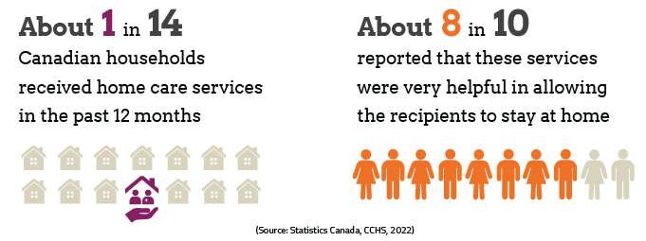
Home Care Services Helped the Recipient Stay at Home Key findings, 2022
Definition: This indicator measures the percentage of households where at least one household member received home care services in the past 12 months and reported that these services were very helpful in allowing the recipient(s) to stay at home.

Slide 25
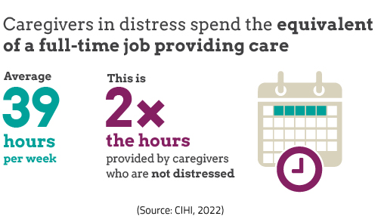
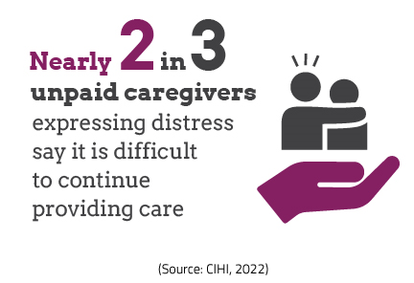
Caregiver Distress Key findings, 2022–2023
Definition: The proportion of clients with unpaid caregivers experiencing distress, among caregivers of long-stay home care clients.

Slide 26
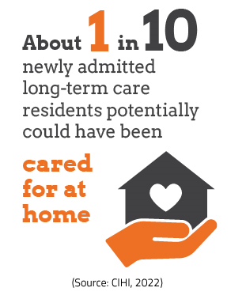
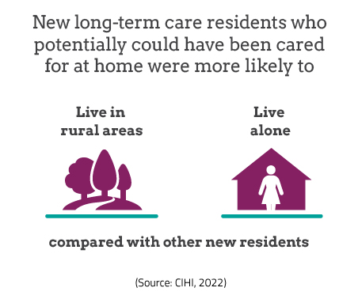
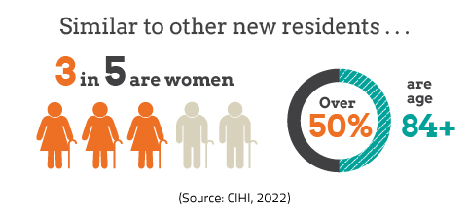
New Long-Term Care Residents Who Potentially Could Have Been Cared for at Home Key findings, 2022–2023
Definition: The percentage of newly admitted long-term care residents who have a clinical profile similar to that of clients cared for at home with formal supports in place.

Slide 27
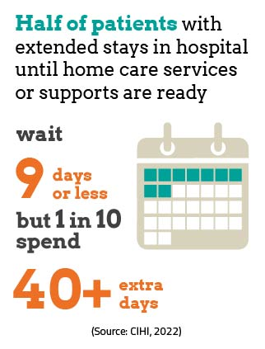
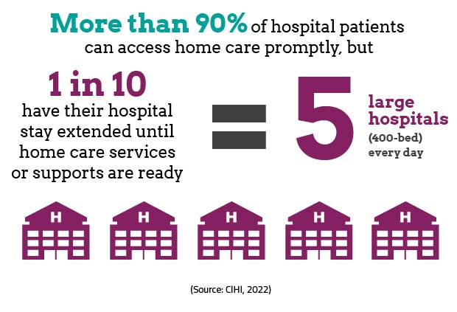
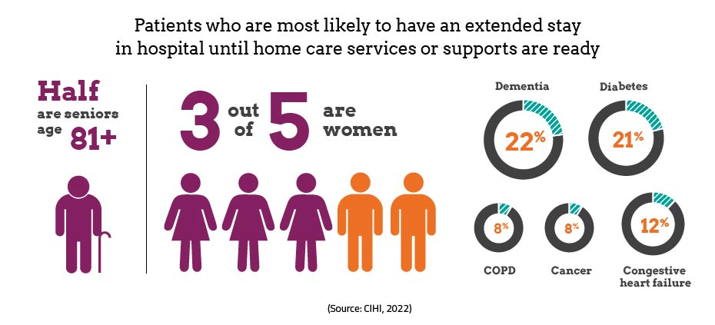
Hospital Stay Extended Until Home Care Services or Supports Ready Key findings, 2022–2023
Definition: The median number of days patients remain in hospital when no longer requiring it, until home care services or supports are ready.

Slide 28
How to cite this document: Canadian Institute for Health Information. Shared Health Priorities: Measuring Access to Mental Health and Substance Use Services and to Home and Community Care — Overview and Update. Ottawa, ON: CIHI; November 2023.
Additional resources
More information and results are available:
Shared Health Priorities
Measuring access to priority health services
Your Health System: In Brief
Contact information
sharedhealthpriorities@cihi.ca
cihi.ca

Slide 29
cihi.ca
sharedhealthpriorities@cihi.ca

